Slide 1
Module3_CPU_Scheduling
Reference: “OPERATING SYSTEM CONCEPTS”, ABRAHAM SILBERSCHATZ, PETER BAER GALVIN, GREG GAGNE , Wiley publications.

Slide 2
Objectives
To introduce CPU scheduling, which is the basis for multiprogrammed operating systems
To describe various CPU-scheduling algorithms
To discuss evaluation criteria for selecting a CPU-scheduling algorithm for a particular system

Slide 3
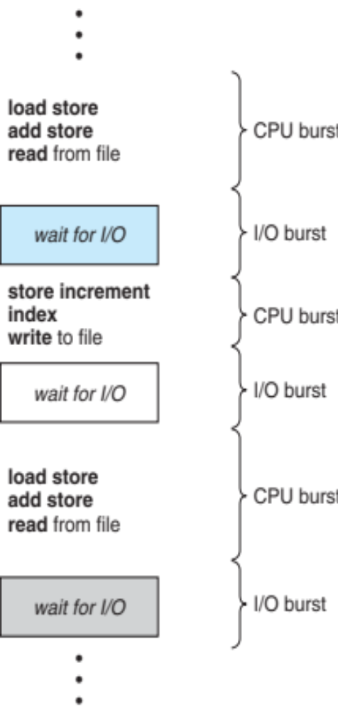
Basic Concepts
Maximum CPU utilization is obtained with multiprogramming
CPU–I/O Burst Cycle – Process execution consists of a cycle of CPU execution and I/O wait
CPU burst followed by I/O burst
CPU burst distribution is of main concern
CPU Burst Time: The amount of time a process executes before it goes to wait state

Slide 4
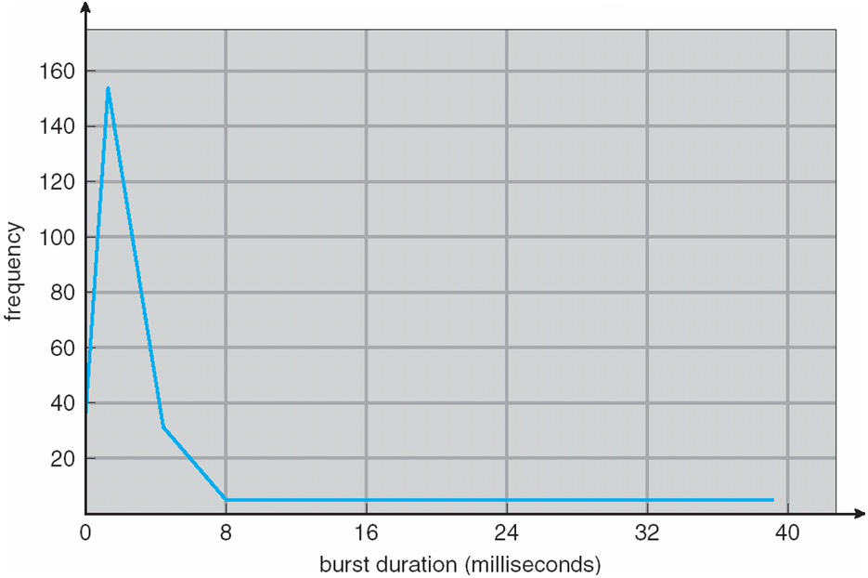
Histogram of CPU-burst Times

Slide 5

CPU Scheduler
Short-term scheduler selects from among the processes in ready queue, and allocates the CPU to one of them
  Queue may be ordered in various ways
CPU scheduling decisions may take place when a process:
  1. Switches from running to waiting state
  2. Switches from running to ready state
  3. Switches from waiting to ready
  Terminates
Scheduling under 1 and 4 is nonpreemptive
All other scheduling is preemptive
  Consider access to shared data
  Consider preemption while in kernel mode
  Consider interrupts occurring during crucial OS activities

Slide 6
Dispatcher
Dispatcher module gives control of the CPU to the process selected by the short-term scheduler; this involves:
  switching context
  switching to user mode
  jumping to the proper location in the user program to restart that program
Dispatch latency – time taken by the the dispatcher to stop one process and start another running

Slide 7
Scheduling Criteria
CPU utilization – keep the CPU as busy as possible
Throughput – # of processes that complete their execution per time unit
Turnaround time – amount of time to execute a particular process
Waiting time – amount of time a process has been waiting in the ready queue
Response time – amount of time taken from when a request was submitted until the first response is produced, not output (for time-sharing environment)

Slide 8
Scheduling Algorithm Optimization Criteria
Maximize CPU utilization
Maximize throughput
Minimize turnaround time
Minimize waiting time
Minimize response time
uptime -> Linux command
system calls
time
sched_getscheduler()
sched_setscheduler()

Slide 9
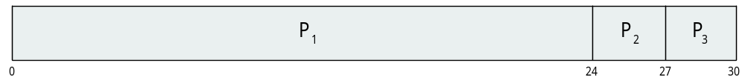
First- Come, First-Served (FCFS) Scheduling
Example 1: Consider the following processes with their burst time. Use FCFS to schedule the processes and compute the average waiting time.
Process ID Burst Time
P₁ 24
P₂ 3
P₃ 3
Suppose that the processes arrive in the order: P₁ , P₂ , P₃
The Gantt Chart for the schedule is:
Waiting time for P₁ = 0; P₂ = 24; P₃ = 27
Average waiting time: (0 + 24 + 27)/3 = 17

Slide 10
First- Come, First-Served (FCFS) Scheduling
Example 1: Continued
The Gantt Chart for the schedule is:
Waiting time for P₁ = 0; P₂ = 24; P₃ = 27
Average waiting time: (0 + 24 + 27)/3 = 17
Process ID | Burst Time | Completion Time | TurnAround Time | Wait Time
P1 | 24 | 24 | 24 | 0
P2 | 3 | 27 | 27 | 24
P3 | 3 | 30 | 30 | 27
Turnaround Time = Completion Time - Arrival Time
Waiting Time = Turn Around Time - Burst Time

Slide 11

FCFS Scheduling (Cont.)
Example 1: Continued
Suppose that the processes arrive in the order: P₂ , P₃ , P₁
Process ID Burst Time
P₁ 24
P₂ 3
P₃ 3
The Gantt chart for the schedule is:
Waiting time for P₁ = 6; P₂ = 0; P₃ = 3
Average waiting time: (6 + 0 + 3)/3 = 3
Much better than previous case
Performance of FCFS is dynamic
  Convoy effect - short process behind long process
  - Consider one CPU-bound and many I/O-bound processes

Slide 12
FCFS Scheduling (Cont.)
Convoy Effect
FCFS algorithm is non-preemptive, that is, once CPU time has been allocated to a process, other processes can get CPU time only after the current process has finished. This property of FCFS scheduling leads to the situation called Convoy Effect.
Suppose there is one CPU intensive (large burst time) process in the ready queue, and several other processes with relatively less burst times but are Input/Output (I/O) bound (Need I/O operations frequently).
  The I/O bound processes are first allocated CPU time. As they are less CPU intensive, they quickly get executed and goto I/O queues.
  Now, the CPU intensive process is allocated CPU time. As its burst time is high, it takes time to complete.
  While the CPU intensive process is being executed, the I/O bound processes complete their I/O operations and are moved back to ready queue.
  However, the I/O bound processes are made to wait as the CPU intensive process still hasn’t finished. This leads to I/O devices being idle.
  When the CPU intensive process gets over, it is sent to the I/O queue so that it can access an I/O device.
  Meanwhile, the I/O bound processes get their required CPU time and move back to I/O queue.
  However, they are made to wait because the CPU intensive process is still accessing an I/O device. As a result, the CPU is sitting idle now.
  Hence in Convoy Effect, one slow process slows down the performance of the entire set of processes, and leads to wastage of CPU time and other devices.

Slide 13
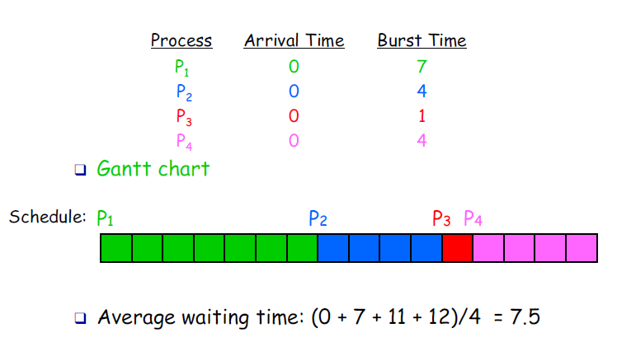
First- Come, First-Served (FCFS) Scheduling
Example 2

Slide 14
First- Come, First-Served (FCFS) Scheduling
Example 2: Continued
The Gantt Chart for the schedule is:
Average waiting time: (0 +7+11+12)/4 = 7.5
Process ID | Burst Time | Completion Time | TurnAround Time | Wait Time
P1 | 7 | 7 | 7 | 0
P2 | 4 | 11 | 11 | 7
P3 | 1 | 12 | 12 | 11
P4 | 4 | 16 | 16 | 12

Slide 15
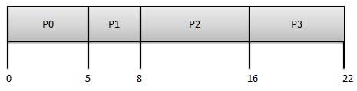
First- Come, First-Served (FCFS) Scheduling
Example 3: Consider the following processes with their burst time and arrival time. Use FCFS to schedule the processes and compute the average waiting time.
The Gantt Chart for the schedule is:
Average Waiting Time: (0+4+6+13) / 4 = 5.75
Process ID | BurstTime | ArrivalTime
P0 | 5 | 0
P1 | 3 | 1
P2 | 8 | 2
P3 | 6 | 3

Slide 16
First- Come, First-Served (FCFS) Scheduling
Example 3 (cont’d):
The Gantt Chart for the schedule is:
Average Waiting Time: (0+4+6+13) / 4 = 5.75
Process ID | Burst Time | Arrival Time | Completion Time | TurnAround Time | Wait Time
P0 | 5 | 0 | 5 | 5 | 0
P1 | 3 | 1 | 8 | 7 | 4
P2 | 8 | 2 | 16 | 14 | 6
P3 | 6 | 3 | 22 | 19 | 13

Slide 17

First- Come, First-Served (FCFS) Scheduling
Example 4: Consider the following processes with their burst time and arrival time. Use FCFS to schedule the processes and compute the average waiting time.
The Gantt Chart for the schedule is:
Average waiting time = (0 + 5 + 7 + 7)/4 = 4
Process ID | Burst Time | Arrival Time
P1 | 7 | 0
P2 | 4 | 2
P3 | 1 | 4
P4 | 4 | 5

Slide 18
First- Come, First-Served (FCFS) Scheduling
Example 4: (continued)
The Gantt Chart for the schedule is:
Average waiting time = (0 + 5 + 7 + 7)/4 = 4.75
Process ID | Burst Time | Arrival Time | Completion Time | TurnAround Time | Wait Time
P1 | 7 | 0 | 7 | 7 | 0
P2 | 4 | 2 | 11 | 9 | 5
P3 | 1 | 4 | 12 | 8 | 7
P4 | 4 | 5 | 16 | 11 | 7

Slide 19
Shortest-Job-First (SJF) Scheduling
Associate with each process the length of its next CPU burst
  Use these lengths to schedule the process with the shortest time
SJF is optimal – gives minimum average waiting time for a given set of processes
  The difficulty is knowing the length of the next CPU request
  Could ask the user

Slide 20
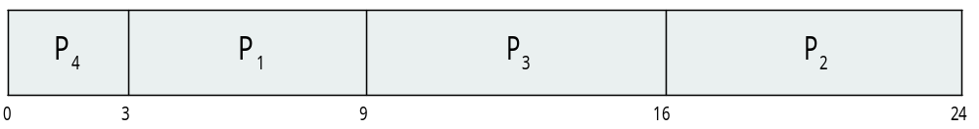
SJF – Example 1
Example 1: Consider the following processes with their burst time. Use SJF to schedule the processes and compute the average waiting time.
SJF scheduling chart
Average waiting time = (3 + 16 + 9 + 0) / 4 = 7
Process ID | Burst Time
P1 | 6
P2 | 8
P3 | 7
P4 | 3

Slide 21
SJF – Example 1 (cont’d)
Scheduling Table
SJF scheduling chart
Average waiting time = (3 + 16 + 9 + 0) / 4 = 7
Process ID | Burst Time | Completion Time | TurnAround Time | Wait Time
P1 | 6 | 9 | 9 | 3
P2 | 8 | 24 | 24 | 16
P3 | 7 | 16 | 16 | 9
P4 | 3 | 3 | 3 | 0

Slide 22
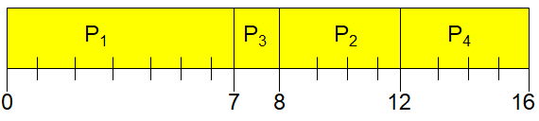
SJF Scheduling - Example
Example 2: Consider the following processes with their burst time and arrival time. Use SJF to schedule the processes and compute the average waiting time.
The Gantt Chart for the schedule is:
Average waiting time = (0 + 6 + 3 + 7)/4 = 4
Process ID | Burst Time | Arrival Time
P1 | 7 | 0
P2 | 4 | 2
P3 | 1 | 4
P4 | 4 | 5

Slide 23
SJF Scheduling - Example
Example 2: (continued)
The Gantt Chart for the schedule is:
Average waiting time = (0 + 6 + 3 + 7)/4 = 4
Process ID | Burst Time | Arrival Time | Completion Time | TurnAround Time | Wait Time
P1 | 7 | 0 | 7 | 7 | 0
P2 | 4 | 2 | 12 | 10 | 6
P3 | 1 | 4 | 8 | 4 | 3
P4 | 4 | 5 | 16 | 11 | 7

Slide 24
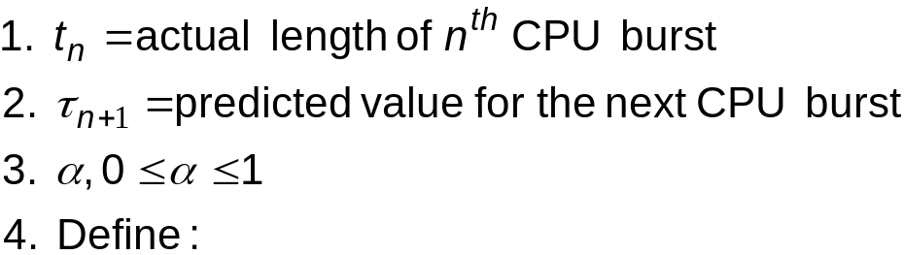
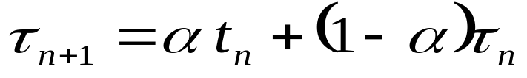
Determining Length of Next CPU Burst
Can only estimate the length – should be similar to the previous one
  Then pick process with shortest predicted next CPU burst
Can be done by using the length of previous CPU bursts, using exponential averaging
Commonly, α set to ½
Preemptive version of SJF is called Shortest-Remaining-Time-First (SRTF)

Slide 25
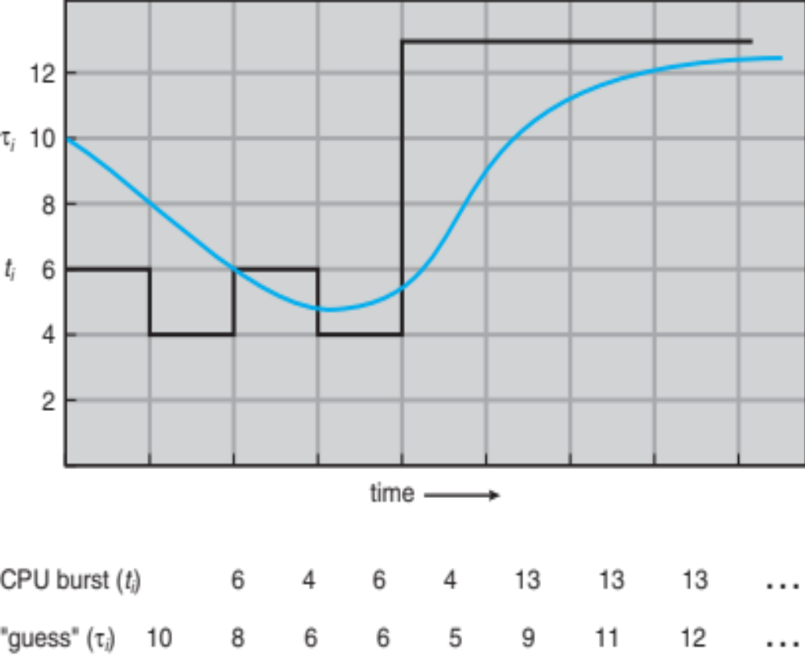
Prediction of the Length of the Next CPU Burst

Slide 26
Examples of Exponential Averaging
α =0
  τ_{n+1} = τ_{n}
  Recent history does not count
α =1
  τ_{n+1} = α t_{n}
  Only the actual last CPU burst counts
If we expand the formula, we get:
    τ_{n+1} = α t_{n}+(1 - α)α t_{n} ₋₁ + …
    +(1 - α )^{j} α t_{n} _{-j} + …
    +(1 - α )^{n +1} τ₀
Since both α and (1 - α) are less than or equal to 1, each successive term has less weight than its predecessor

Slide 27

Example of Shortest-remaining-time-first
Preemptive version of SJF is called Shortest-Remaining-Time-First (SRTF)
Now we add the concepts of varying arrival times and preemption to the analysis
ProcessaArrival TimeT Burst Time Completion Time Wait Time
P₁ 0 8 17 9
P₂ 1 4 5 0
P₃ 2 9 26 15
P₄ 3 5 10 2
Preemptive SJF Gantt Chart
Average waiting time = [(10-1)+(1-1)+(17-2)+5-3)]/4 = 26/4 = 6.5 msec

Slide 28
Example of Preemptive SJF
Process Arrival Time Burst Time
P₁ 0 7
P₂ 2 4
P₃ 4 1
P₄ 5 4
SJF (preemptive)
Average waiting time = (9 + 1 + 0 +2)/4 = 3
P₁
P₂
P₃
P₂
P₄
P₁
0
2
4
5
7
11
16

Slide 29
Example of Preemptive SJF
Example:
Process ID | Burst Time | Arrival Time
P1 | 7 | 0
P2 | 4 | 2
P3 | 1 | 4
P4 | 4 | 5
Process ID | Burst Time | Arrival Time | Turn Around Time | Wait Time
P1 | 7 | 0 | 16 | 9
P2 | 4 | 2 | 5 | 1
P3 | 1 | 4 | 1 | 0
P4 | 4 | 5 | 6 | 2

Slide 30
Priority Scheduling
A priority number (integer) is associated with each process
The CPU is allocated to the process with the highest priority (smallest integer ≡ highest priority)
  Preemptive
  Nonpreemptive
SJF is priority scheduling where priority is the inverse of predicted next CPU burst time
Problem ≡ Starvation – low priority processes may never execute
Solution ≡ Aging – as time progresses increase the priority of the process

Slide 31
Priority Scheduling - Example
Example 1: Consider the following processes with their burst time and priority. Use priority to schedule the processes and compute the average waiting time.
Process ID | Burst Time | Priority
P1 | 10 | 3
P2 | 1 | 1
P3 | 2 | 4
P4 | 1 | 5
P5 | 5 | 2

Slide 32
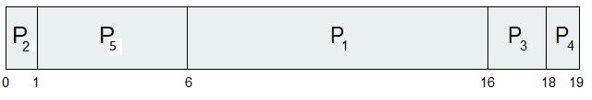
Priority Scheduling - Example
Example 1 (cont’d) :
Priority scheduling Gantt Chart:
Average waiting time = (6+0+16+18+1)/5 = 8.2 msec
Process ID | Burst Time | Priority | TurnAround Time | Wait Time
P1 | 10 | 3 | 16 | 6
P2 | 1 | 1 | 1 | 0
P3 | 2 | 4 | 18 | 16
P4 | 1 | 5 | 19 | 18
P5 | 5 | 2 | 6 | 1

Slide 33
Priority Scheduling - Example
Example 2: Consider the following processes with their burst time and priority. Use priority to schedule the processes and compute the average waiting time.
Process ID | Priority | Arrival Time | Burst Time
1 | 2 | 0 | 1
2 | 6 | 1 | 7
3 | 3 | 2 | 3
4 | 5 | 3 | 6
5 | 4 | 4 | 5
6 | 10 | 5 | 15
7 | 9 | 6 | 8

Slide 34
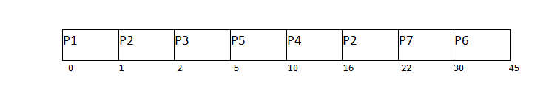
Priority Scheduling - Example
Example 2 (continued): Gantt Chart
Average Waiting Time = (0+14+0+7+1+25+16)/7 = 63/7 = 9 units
Process ID | Priority | Arrival Time | Burst Time | Completion Time | Turn Around Time | Wait Time
1 | 2 | 0 | 1 | 1 | 1 | 0
2 | 6 | 1 | 7 | 22 | 21 | 14
3 | 3 | 2 | 3 | 5 | 3 | 0
4 | 5 | 3 | 6 | 16 | 13 | 7
5 | 4 | 4 | 5 | 10 | 6 | 1
6 | 10 | 5 | 15 | 45 | 40 | 25
7 | 9 | 6 | 8 | 30 | 24 | 16

Slide 35
Round Robin (RR)
Each process gets a small unit of CPU time (time quantum q), usually 10-100 milliseconds.
  After this time has elapsed, the process is preempted and added to the end of the ready queue.
If there are n processes in the ready queue and the time quantum is q, then each process gets 1/n of the CPU time in chunks of at most q time units at once.
  No process waits more than (n-1)q time units.
Timer interrupts every quantum to schedule next process
Performance
  q large ⇒ FIFO
  q small ⇒ q must be large with respect to context switch, otherwise overhead is too high

Slide 36

Example of RR with Time Quantum = 4
Process Burst Time
P₁ 24
P₂ 3
P₃ 3
The Gantt chart is:
Typically, higher average turnaround than SJF, but better response
q should be large compared to context switch time
q usually 10ms to 100ms, context switch < 10 usec

Slide 37
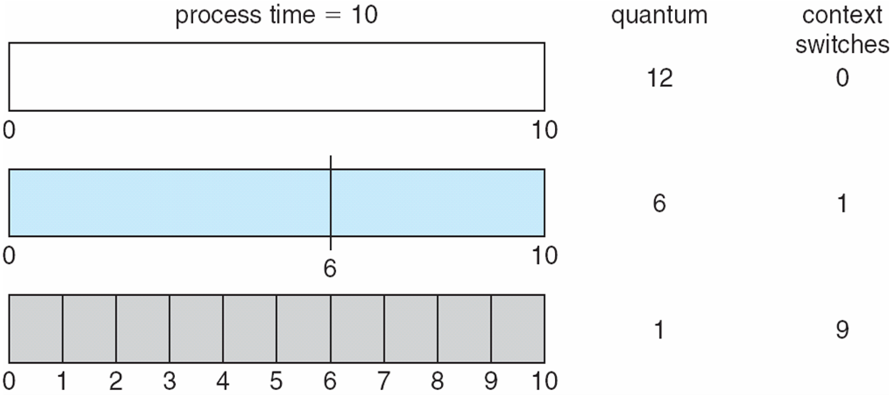
Time Quantum and Context Switch Time

Slide 38
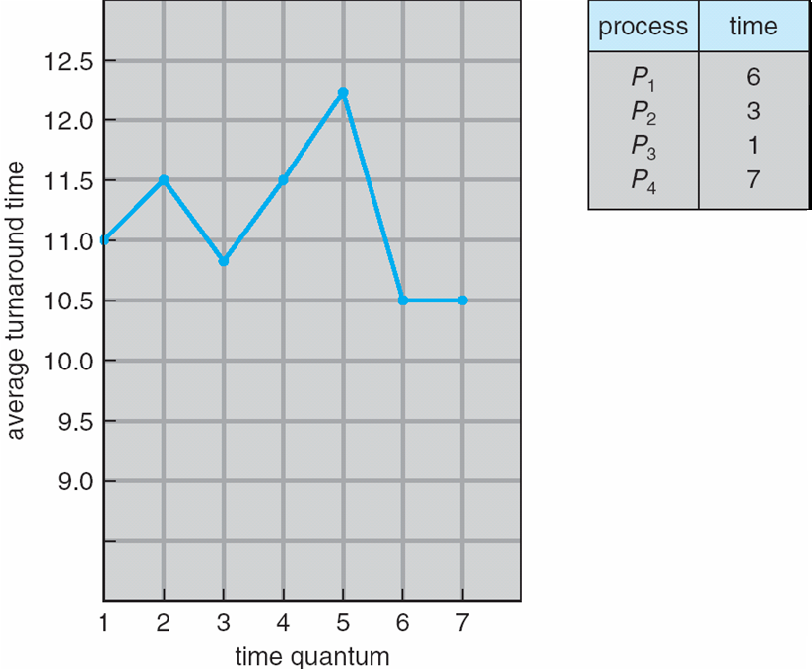
Turnaround Time Varies With The Time Quantum
80% of CPU bursts should be shorter than q

Slide 39
Multilevel Queue
Ready queue is partitioned into separate queues, eg:
  foreground (interactive)
  background (batch)
Process is permanently in a given queue
Each queue has its own scheduling algorithm:
  foreground – RR
  background – FCFS
Scheduling must be done between the queues:
  Fixed priority scheduling; (i.e., serve all from foreground then from background). Possibility of starvation.
  Time slice – each queue gets a certain amount of CPU time which it can schedule amongst its processes; i.e., 80% to foreground in RR
  20% to background in FCFS

Slide 40
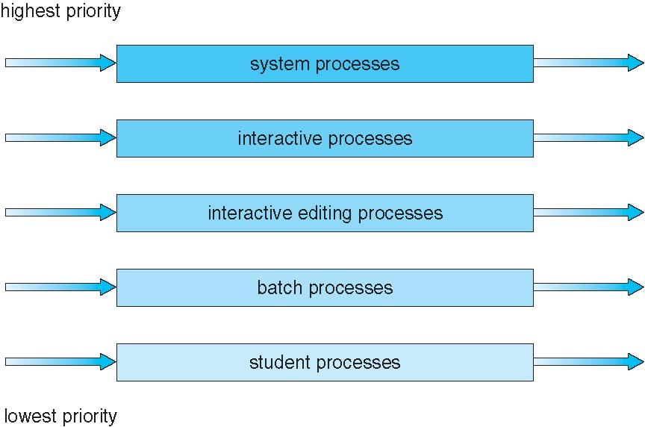
Multilevel Queue Scheduling

Slide 41
Multilevel Feedback Queue
A process can move between the various queues; aging can be implemented this way
Multilevel-feedback-queue scheduler is defined by the following parameters:
  number of queues
  scheduling algorithms for each queue
  method used to determine when to upgrade a process
  method used to determine when to demote a process
  method used to determine which queue a process will enter when that process needs service

Slide 42

Example of Multilevel Feedback Queue
Three queues:
  Q₀ – RR with time quantum 8 milliseconds
  Q₁ – RR time quantum 16 milliseconds
  Q₂ – FCFS
Scheduling
  A new job enters queue Q₀ which is served by FCFS
    When it gains CPU, job receives 8 milliseconds
    If it does not finish in 8 milliseconds, job is moved to queue Q₁
  At Q₁ job is again served by FCFS and receives 16 additional milliseconds
    If it still does not complete, it is preempted and moved to queue Q₂

Slide 43
Multiple-Processor Scheduling
CPU scheduling more complex when multiple CPUs are available
Homogeneous processors within a multiprocessor
Asymmetric multiprocessing – only one processor accesses the system data structures, alleviating the need for data sharing
Symmetric multiprocessing (SMP) – each processor is self-scheduling, all processes in common ready queue, or each has its own private queue of ready processes
  Currently, most common
Processor affinity – process has affinity for processor on which it is currently running
  soft affinity
  hard affinity
  Variations including processor sets

Slide 44
Multiple-Processor Scheduling – Load Balancing
If SMP, need to keep all CPUs loaded for efficiency
Load balancing attempts to keep workload evenly distributed
Push migration – periodic task checks load on each processor, and if found pushes task from overloaded CPU to other CPUs
Pull migration – idle processors pulls waiting task from busy processor

Slide 45
Multicore Processors
Recent trend to place multiple processor cores on same physical chip
Faster and consumes less power
Multiple threads per core is also growing
  Takes advantage of memory stall to make progress on another thread while memory retrieve happens

Slide 46
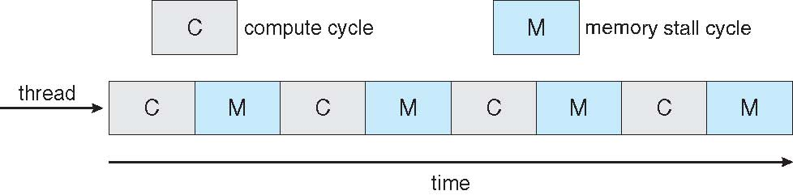

Multithreaded Multicore System

Slide 47
Windows Scheduling
Windows uses priority-based preemptive scheduling
Highest-priority thread runs next
Dispatcher is scheduler
Thread runs until (1) blocks, (2) uses time slice, (3) preempted by higher-priority thread
Real-time threads can preempt non-real-time
32-level priority scheme
Variable class is 1-15, real-time class is 16-31
Priority 0 is memory-management thread
Queue for each priority
If no run-able thread, runs idle thread

Slide 48
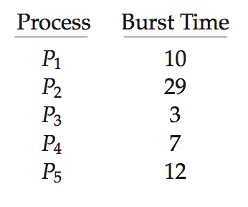
Algorithm Evaluation
How to select CPU-scheduling algorithm for an OS?
Determine criteria, then evaluate algorithms
Deterministic modeling
  Type of analytic evaluation
  Takes a particular predetermined workload and defines the performance of each algorithm for that workload
Consider 5 processes arriving at time 0:

Slide 49
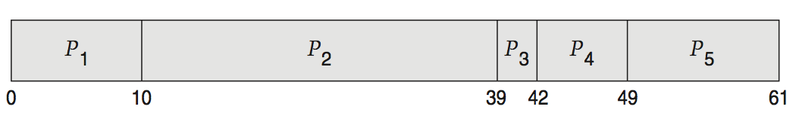
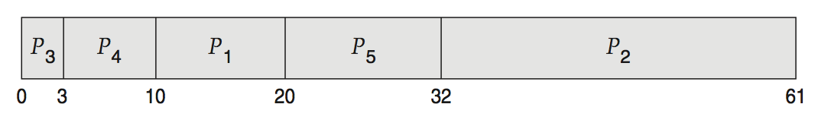
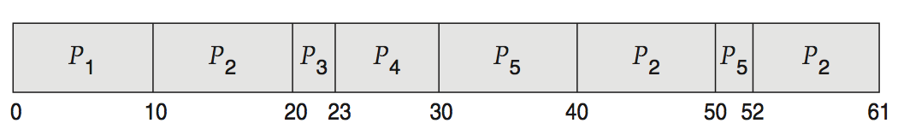
Deterministic Evaluation
For each algorithm, calculate minimum average waiting time
Simple and fast, but requires exact numbers for input, applies only to those inputs
  FCFS is 28ms:
  Non-preemptive SFJ is 13ms:
  RR is 23ms:

Slide 50
Queueing Models
Describes the arrival of processes, and CPU and I/O bursts probabilistically
  Commonly exponential, and described by mean
  Computes average throughput, utilization, waiting time, etc
Computer system described as network of servers, each with queue of waiting processes
  Knowing arrival rates and service rates
  Computes utilization, average queue length, average wait time, etc

Slide 51
Little’s Formula
n = average queue length
W = average waiting time in queue
λ = average arrival rate into queue
Little’s law – in steady state, processes leaving queue must equal processes arriving, thus:
n = λ x W
  Valid for any scheduling algorithm and arrival distribution
For example, if on an average 7 processes arrive per second, and normally 14 processes in queue, then average wait time per process = 2 seconds

Slide 52
Simulations
Queueing models limited
Simulations more accurate
  Programmed model of computer system
  Clock is a variable
  Gather statistics indicating algorithm performance
  Data to drive simulation gathered via
    Random number generator according to probabilities
    Distributions defined mathematically or empirically
    Trace tapes record sequences of real events in real systems

Slide 53
References
For more practice problems
https://www.gatevidyalay.com/round-robin-round-robin-scheduling-examples/

